Slide 1
Matlab Pipeline
By John Stout

Slide 2
Disclaimer
The Matlab Pipeline is still in development. Not every function and script will be generalizable. This is a work in progress.
Please contact John Stout at john.j.stout.jr@gmail.com for specific questions. If you’re in the lab and have my phone number, that also works.
The above contact information should be updated when the matlab pipeline switches hands.

Slide 3
Matlab Pipeline Purposes
Provide a balance between ‘plug-and-chug’ and requiring the user to understand what and how they’re analyzing the data
Implement a shared format for all lab members
Easily share code. This makes it so each lab member does not have to create code to run an analysis that has been used by the lab before. This is how bugs occur in code. If we all share similar code, any uncaught bugs will be caught eventually.
Provide a clear route for new members to learn how to get started with analyzing their data.
Reproduce and replication. By sharing code, we should have an easy time with reproducing and replicating any findings.
Provide a user-friendly way for code organization.

Slide 4
User requirements
The user of Matlab Pipeline should be familiar with these concepts (and how to implement them in matlab):
What is a vector? What is a matrix? Know the difference between 2D vs 3D matrices.
What is the command window? How do you interface with the command window?
The user must have mastery over extracting specific elements from matrix. This is generally easy to master, for example, how do you extract a specific row and column from a matrix? Say row 5, column 8 in a 10x10 matrix? Mathworks will show you how to do this. You can even create a random matrix to try this out!
What is a directory?
How do you save and load .mat files? What is a .mat file?
How to use an index. What is an ‘index’?
Know how to use the find function and know how to use ‘logical indexing’. Note that these two can often be used interchangeably.
How to write and use a ‘for loop’.
What is a script? What is a function? How do you create a script and function?
How do you use a function in the command window? This is critical for using the matlab pipeline.
What is a cell array? How do you use one? This concept is crucial to matlab pipeline and an effective tool for data analysis.
What is a structure array? How do you use one? Similar to above, this is a critical tool.
Google is your friend! Generally, if you have a question, somebody else has had a similar question. Mathworks.com is the best place for finding solutions to your problems

Slide 5
What does matlab pipeline do? What doesn’t matlab pipeline do?
What does Matlab Pipeline do?
Allows the user control over various methods to run certain analyses
You have the ability to get LFP based on timing around a location, or based on spatial binning
You can run various approaches for linear classification on unit data
You can assess granger causality or unit-LFP entrainment
You can assess behavioral metrics like speed, time-spent, changes in lateral position.
Etc…
Note that the list above is not all-inclusive. There are things that it does that are not listed. Additionally, the library will be expanded with time and use.
What doesn’t Matlab Pipeline do?
It generally does not statistically analyze your data.
It typically does not generate figures that you will want to use for publication and presentations.
It may not format your data in the way you want it. While you can use to it extract data and run analyses, when it comes time to statistically assess those relationships, the user may have to flexibly alter their data format.

Slide 6
Finding your function
If you want to run an LFP, or a spike-LFP analysis, find the ‘Neural Analyses’ folder.
If you want to a spike dependent analysis, find the ‘Neuronal Analyses’ folder.
Within the ‘Neural Analyses’ or ‘Neuronal Analyses’ folders, if you are interested in the time domain, say 1 second around T-junction entrance, open the ‘Binned by Time’ folder. If, however, you want to examine data in the spatial domain, say in various bins across the stem, open the ‘Binned by Space’ folder.
If you see ‘Support Functions’, these refer to functions that are independent of spatial or time binning.

Slide 7
Example workflow #1
Goal: Calculate coherence in multiple stem bins
User defined script
Get LFP data in multiple stem bins
Save Data to your folder
Create a script that loads data
get_LFP_binnedStem
User defined directory
Available in matlab pipeline
Visualize and statistically assess
In the script you created, run coherence
User defined script
coherencyc (chronux)
wcoherence (matlab)
Available in matlab pipeline

Slide 8
Step 1: Formatting Rat Data Folders

Slide 9
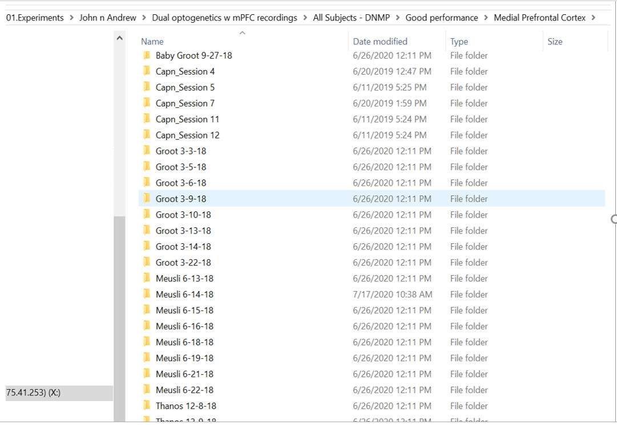
Here is an example. Notice how all rats are stored together. The organization of this data makes it easy to perform any sort of averaging that you want (ie average across sessions, average across rats, average within rats).
Note that not all code in the folder is created to average in anyway you choose. However, you can select which sessions to extract data from. For example, when you run certain functions, you’ll be required to enter if you’d like to change the ‘Looping Index’. If you say ‘Y’, then you must enter which rats to look at.
This is a datafolder

Slide 10
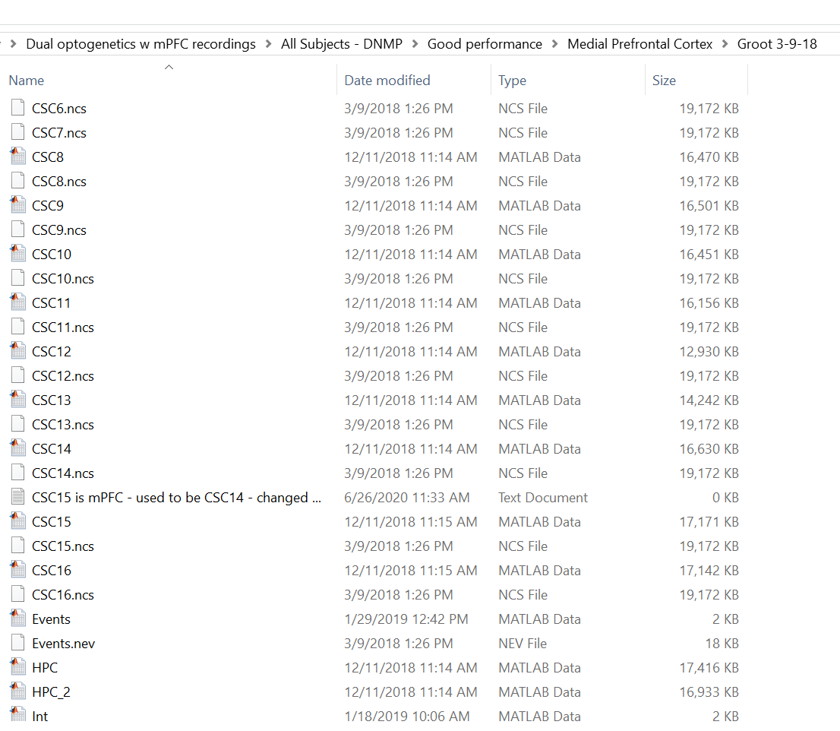
This is the inside of a ‘datafolder’
The ‘datafolder’ is a matlab variable name used to refer to the contents of a session (ie the data).

Slide 11
Step 2: Locate or download the Matlab Pipeline repository

Slide 12
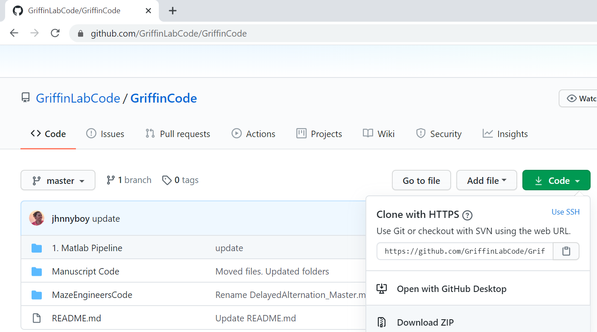
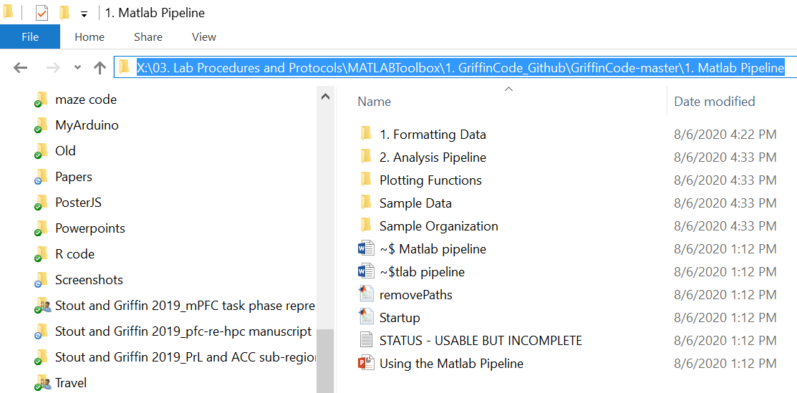
To use the Matlab Pipeline, you must either have a version of Matlab Pipeline downloaded, or you may need to download the ‘GriffinCode’ repository. Do this by selecting the green ‘Code’ button, then ‘Download Zip’. To get the latest matlab pipeline, you can also download this repo.
To get the latest version, check here
Check here

Slide 13
Step 3: Initialize Matlab

Slide 14
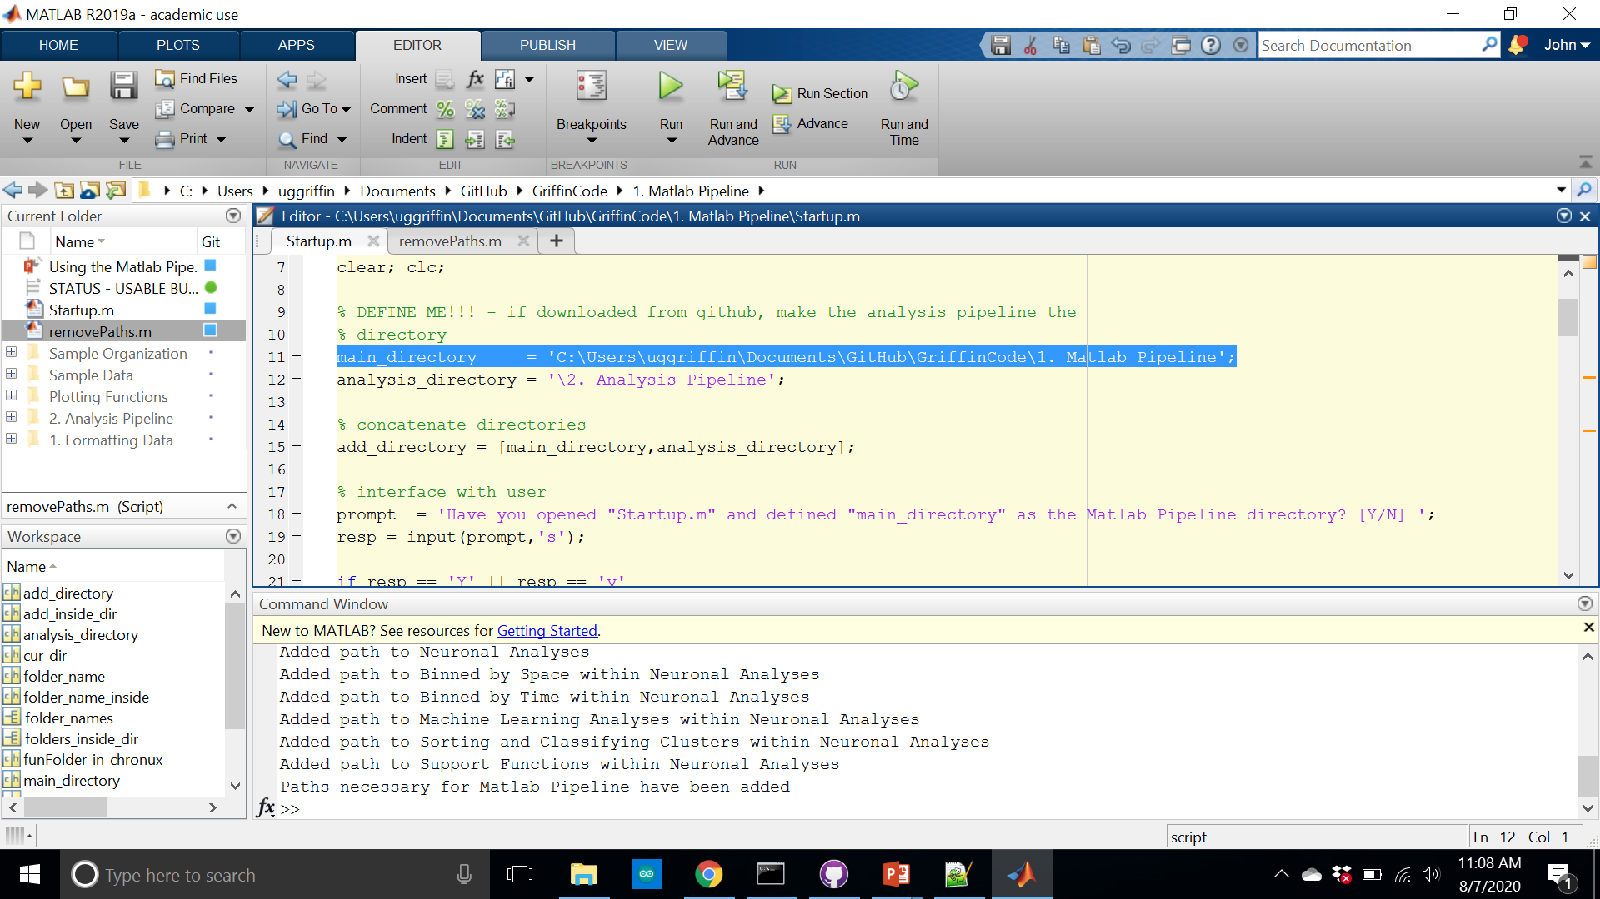
Run ‘Startup’ after you define the ‘main_directory’ variable. This variable should reflect the directory (i.e. the location in your folders) of the ‘Matlab Pipeline’ folder. See the green arrow
This was designed so that you can download this code from github with no attachments to specific directories. Note that ‘removePaths’ does the opposite of ‘Startup’

Slide 15
Step 3: Converting and Formatting Data

Slide 16
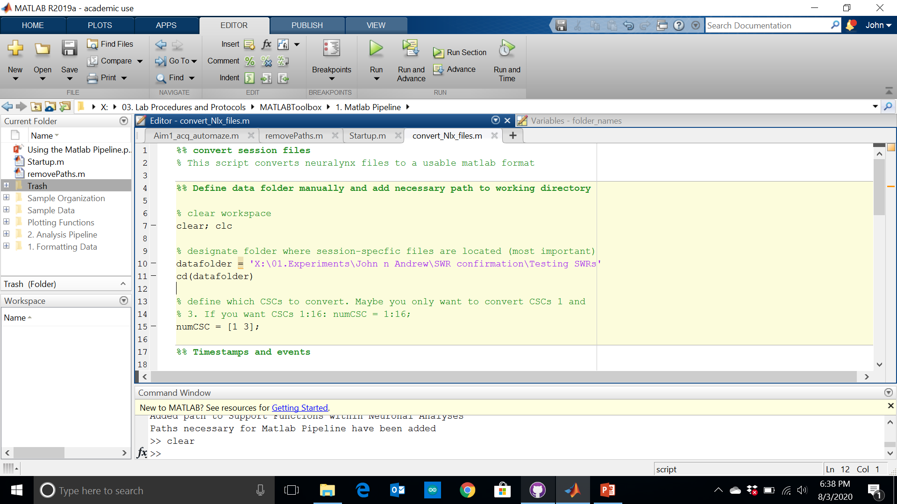
Convert video tracking data, events, and LFP using the ‘convert_Nlx_files’ script.
Make sure to define your ‘datafolder’. This is the directory where your data is stored (see slide 3). Note that before this file, you will most likely have no .mat files. After converting, you’ll have .mat files
Before running, define which CSCs to convert. This variable name is ‘numCSC’

Slide 17
Step 4: Create an Int file

Slide 18
Disclaimer
Some methods implemented in this code are new. Therefore, some files may not exist in older documents. This particularly includes the ‘Int_information’ file which houses the locations where timestamps were taken.
To recreate the plots below, go the sample data folder in the Matlab Pipeline folder and use this directory.

Slide 19
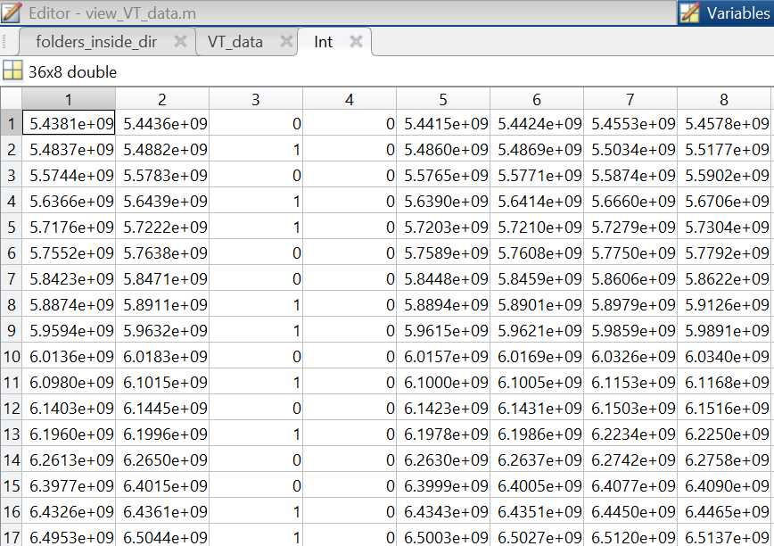
Int file contents
A file of timestamps that denotes when the rat was in a location of interest.
Goal zone entry
T-entry
Goal-arm entry
Stem entry
Return arm entry
Startbox entry
Left = 1
Right = 0
Correct = 0
Incorrect = 1
Timestamps – these can be converted to seconds by dividing by 1e6
Example DNMP Int file

Slide 20
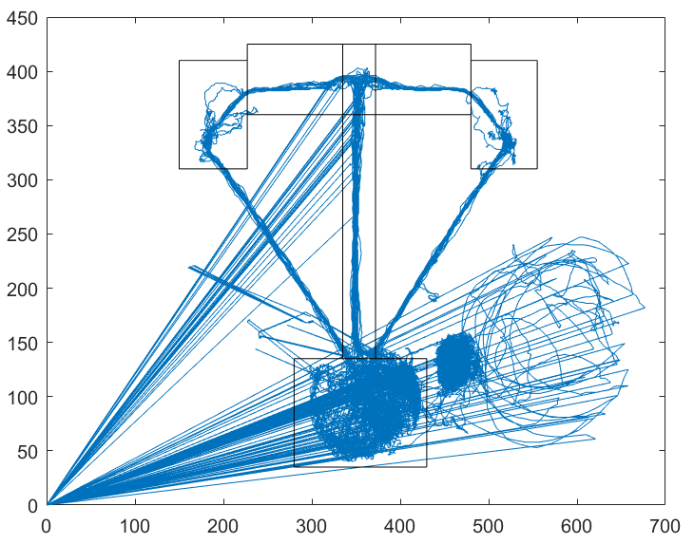
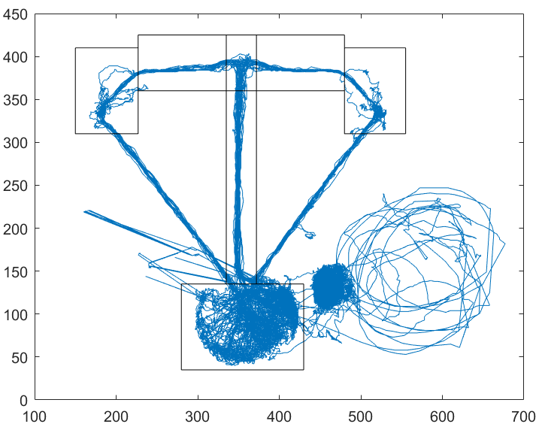
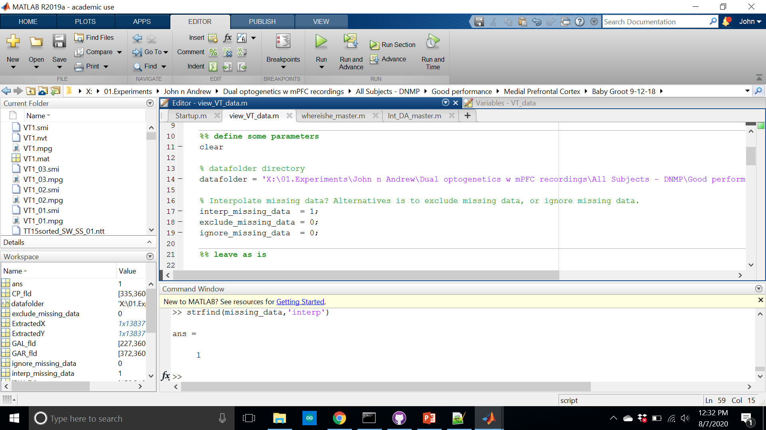
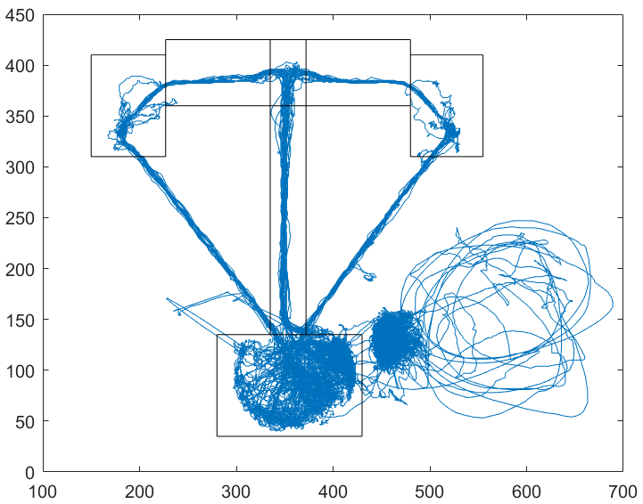
View_VT_data allows you to plot position data and create locations of interest for Int file generation. This is the first step for int file generation.
Note, here is the first case where you can decide whether to interpolate, exclude, or ignore missing video tracking data. This is also the most important time because you’re actively looking at the video tracking data.
The output of this script is ‘Int_information’ – this is required. Please continue to next slide for information on how to change the locations of interest (see green arrows)
ignored
excluded
interpolated

Slide 21
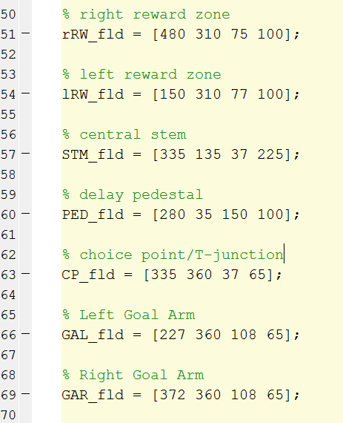
This code is found in ‘view_VT_data.m’
Change these numbers to modify the boxes on the right

Slide 22
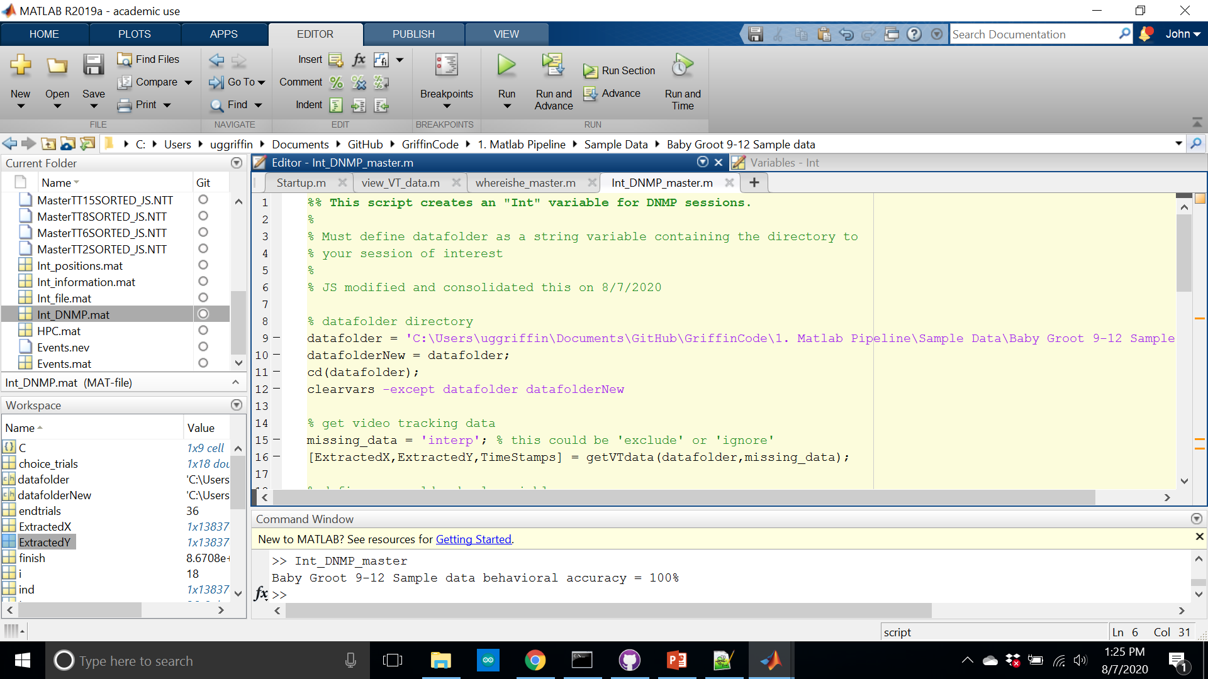
The sample dataset provided was from the DNMP task. Therefore, open, Int_DNMP_master, change the datafolder, define whether you want to exclude, interpolate, or ignore tracking errors, and run the script. See the command window for its output. This rat performed at 100%. The output of this script is the Int file. Here, it will be saved as ‘Int_DNMP’. ‘Int_file’ was the old, less descriptive variable name.

